Slide 1
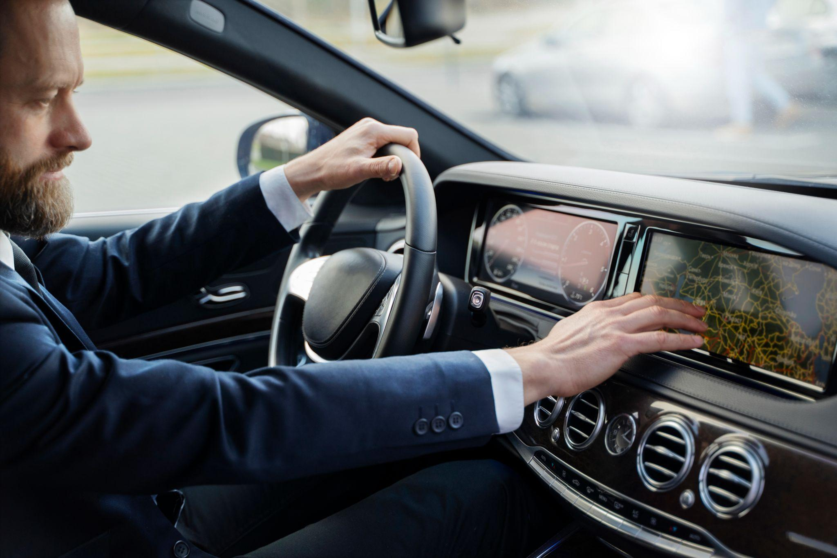
ADAS: Powered Driver Monitoring And Enhanced Child Safety in vehicles
Supervised By:
DR. Abdullah Nabil

Slide 2
Table of contents
01
02
05
03
04
Problem & Challenges
Child Detection
System Overview
Embedded Linux
06
Driver Mentoring System
ECUs

Slide 3
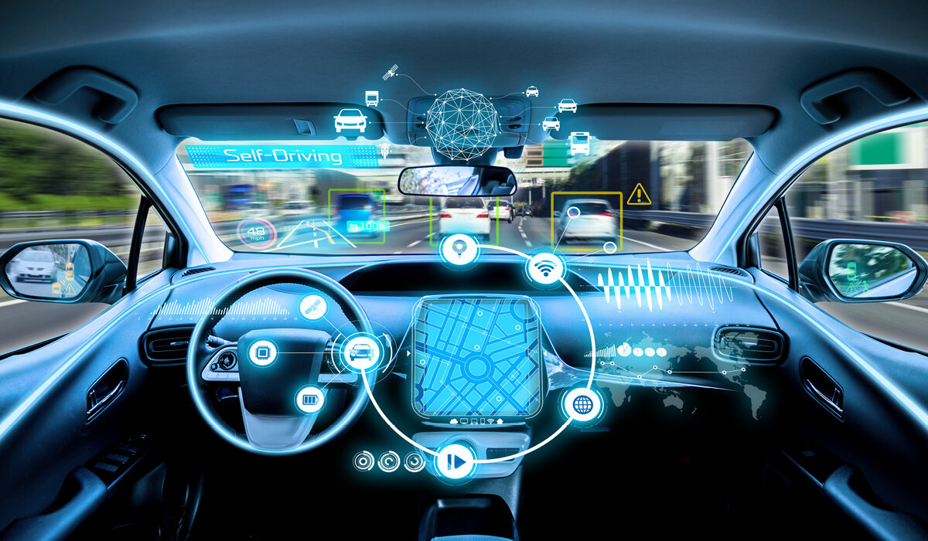
01
Problem & Challenges

Slide 4
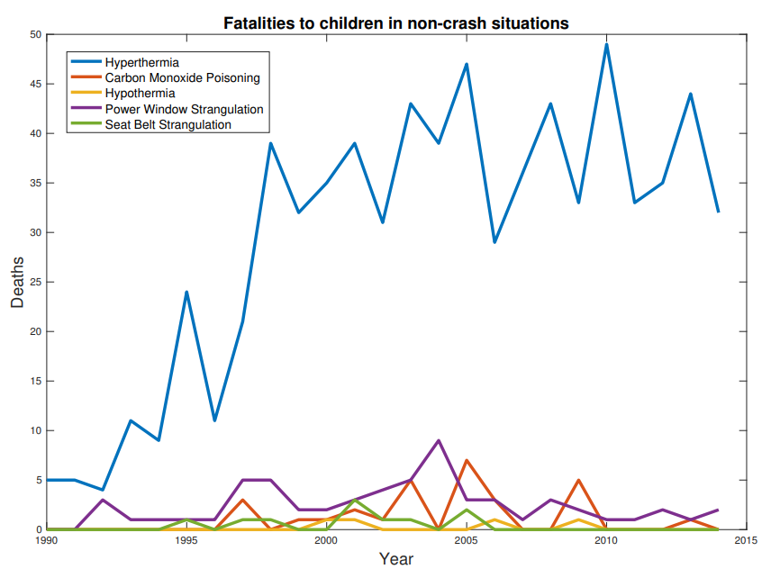
Child
742
10
children under the age of 14 have died in cars in the United States between 1998 and 2017
Every 10 days a child dies from heatstroke
3-5
37
53%
Children bodies heat up three to five times faster than adults
average of children death each year in the United States from heatstroke
of hot car deaths happen because a child is forgotten in the car
U.S. Congress issuing a bill on the subject, suggesting that "all new passenger motor vehicles to be equipped with a child safety alert system”
Notes:
The National Highway Traffic Safety Administration (NHTSA) says that nearly 800 children under the age of 14 have died in cars in the United States between 1998 and 2017.
An average of 37 children die each year in the United States from heatstroke after being left in hot cars.
One child every 10 days.
53% of hot car deaths happen because a child is forgotten in the car.
Children bodies heat up three to five times faster than adults.
U.S. Congress issuing a bill on the subject, suggesting that "all new passenger motor vehicles to be equipped with a child safety alert system“.

Slide 5
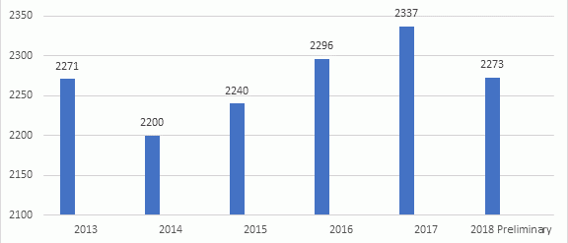
Driver
3,964
people were killed in distracted driving crashes
9,100
deaths per year caused by fatal crashes involve drowsy driving
50%
DMS can reduce the risk of drowsy driving by up to 50%
In Europe, for example, all new cars will be required to have DMS as standard equipment by 2024
$13.2 billion
the expected global DMS market by 2027
Notes:
According to the National Highway Traffic Safety Administration (NHTSA), in 2019, 3,964 people were killed in distracted driving crashes. That's one out of every ten traffic deaths.
The AAA Foundation for Traffic Safety estimates that 20% of fatal crashes involve drowsy driving. That's about 9,100 deaths per year
Studies have shown that DMS can reduce the risk of distracted driving by up to 30% and drowsy driving by up to 50%.
According to a report by Allied Market Research, the global DMS market is expected to reach $13.2 billion by 2027.
In Europe, for example, all new cars will be required to have DMS as standard equipment by 2024.

Slide 6




Availability
$14,300
60%
average price of a new car in Egypt which is higher than the average income which is $2,600
import tax on new cars which makes it very difficult for people to afford to import new cars
12.7 years
50%
the average age of cars in Egypt which is above the global average of 8.5 years
tax break of 50% on the purchase of new cars
Notes:
Central Agency for Public Mobilization and Statistics (CAPMAS), the average age of cars in Egypt is 12.7 years. This is well above the global average of 8.5 years.
In 2022, the average price of a new car in Egypt was $14,300. This is much higher than the average income in Egypt, which is $2,600 per year.
the import tax on new cars is 60%. This makes it very difficult for people to afford to import new cars.
The government of Egypt is trying to address the problem of the high age of cars by offering incentives for people to buy new cars. For example, the government is offering a tax break of 50% on the purchase of new cars.

Slide 7
Challenges
Real-Time Constraints
Ethical and Privacy Concerns
Data Quality and Availability
System Integration

Slide 8
System Overview
02

Slide 9



Our System
AI Models
Embedded linux
Embedded BareMetal

Slide 10
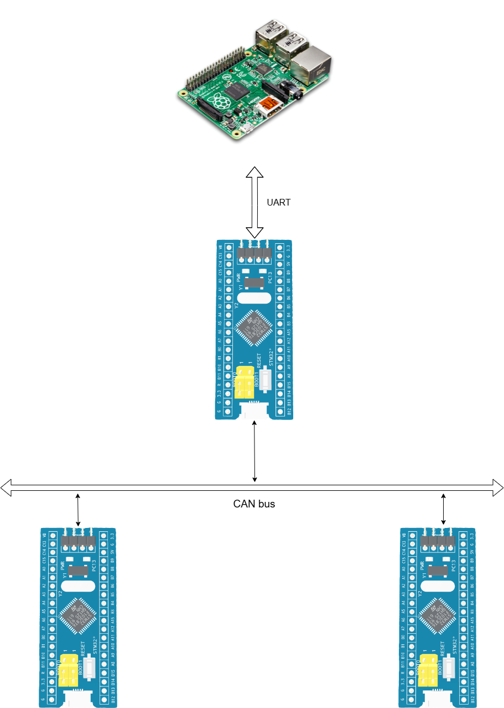

Slide 11
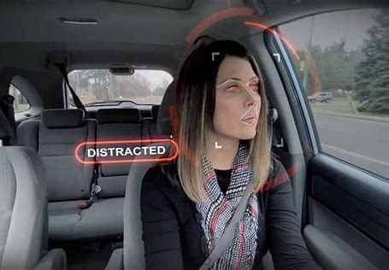
03
Driver Mentoring System

Slide 12
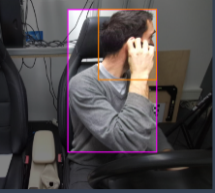
Driver Monitoring System
1
14 Classes
Distraction, drowsiness, and other behaviors
2
Real-Time Monitoring
Alerts drivers to potential safety issues
3
YOLOv10 Model
Deep learning for accurate detection
4
Non-Intrusive
No wearable devices required

Slide 13
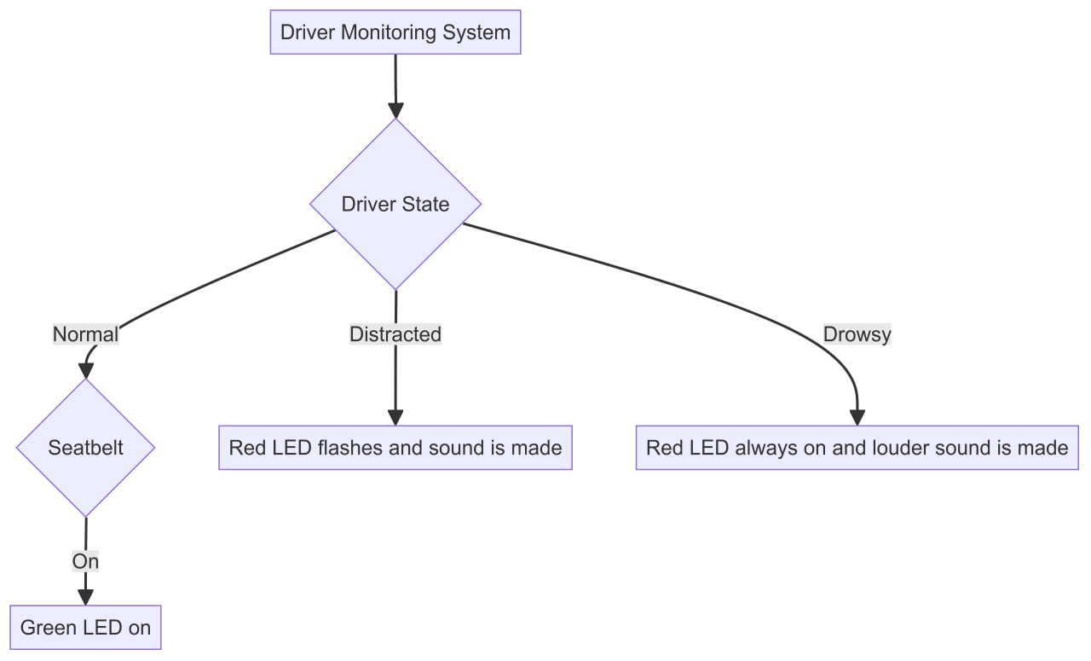

Slide 14
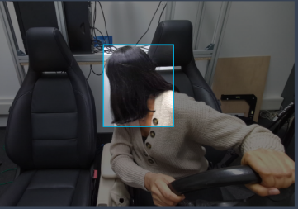
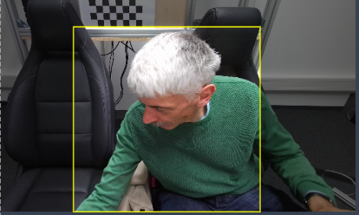
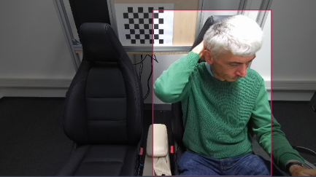
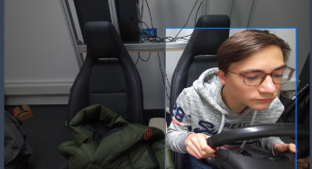
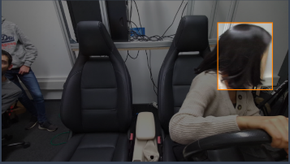
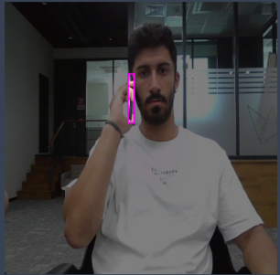
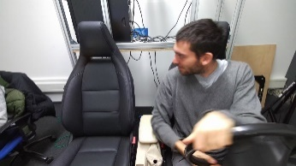



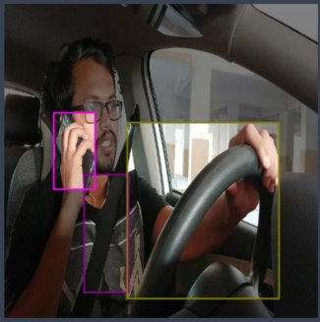
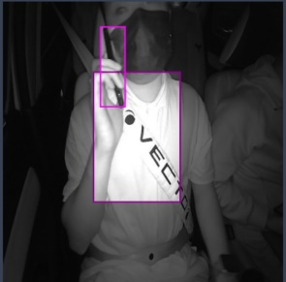

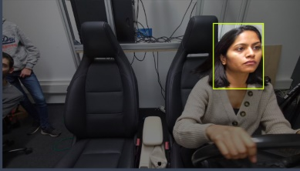
Data Collection
10000
Samples
14 classes

Slide 15
Data Split
TRAIN
72 %
VALIDATION
TEST
18 %
10 %

Slide 16
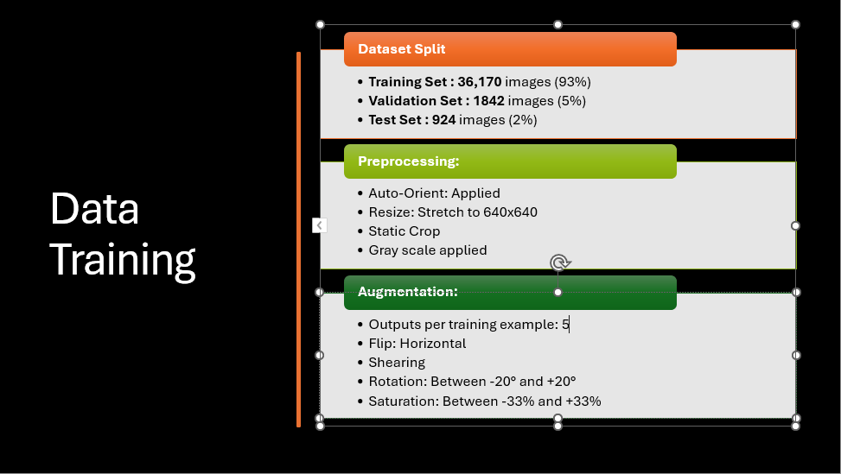

Slide 17
Evaluation Metrics
0.905
P
R
MAP
.905
.918
.945
TRAIN
.905
.918
.946
VALID

Slide 18
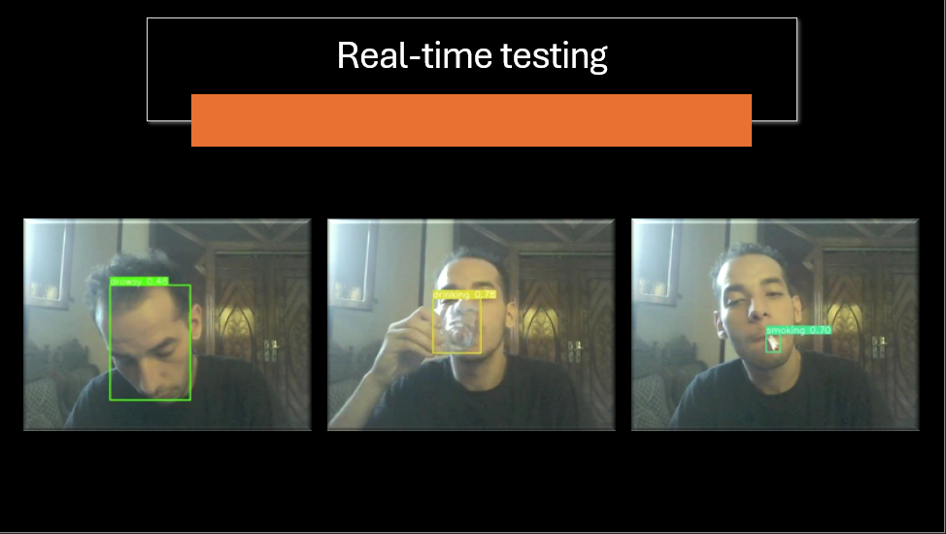
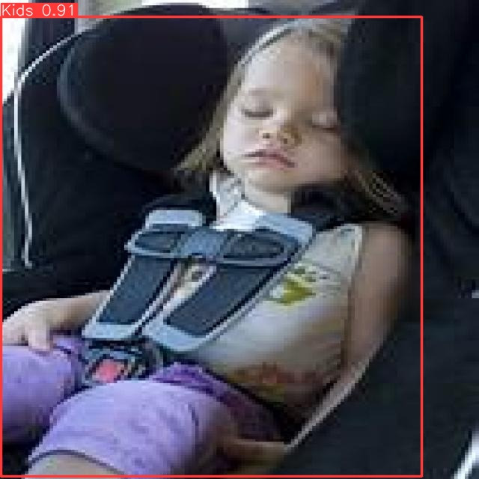
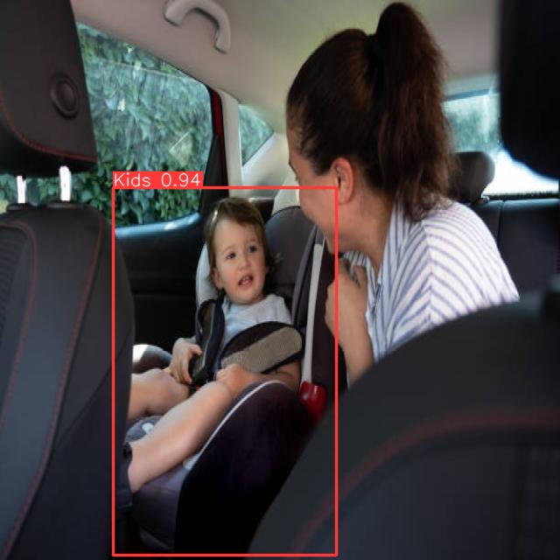
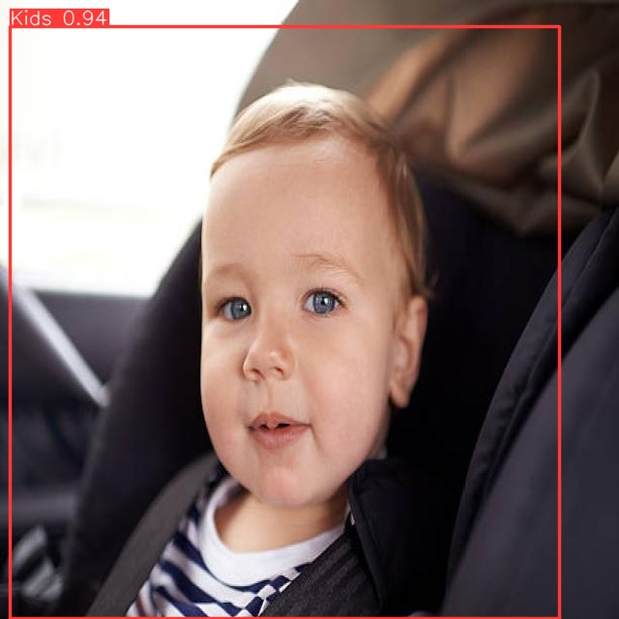
Real-time testing results under different conditions

Slide 19
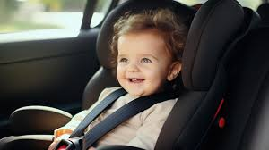
04
Child Detection

Slide 20
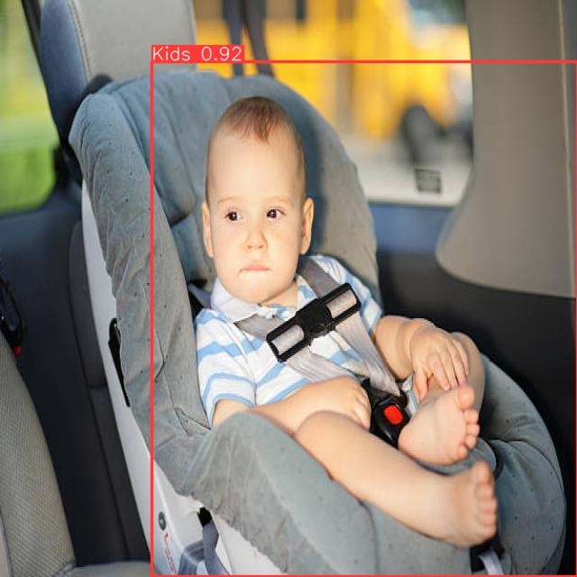
Step-by-step explanation of how the child detection system was implemented.

Slide 21
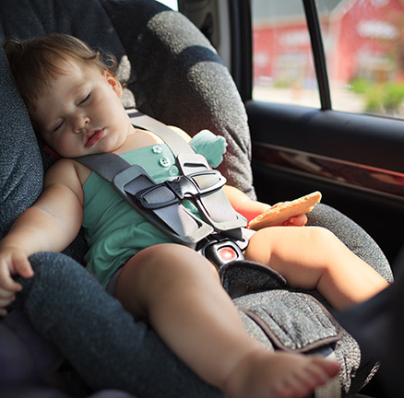

Data Collection
CHILD
TEDDY BEAR
2645
Samples
We collected a comprehensive set of images for child detection
Using Robo flow

Slide 22


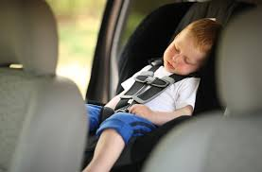
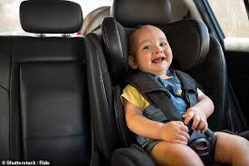
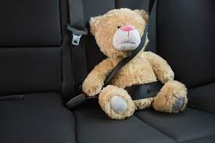
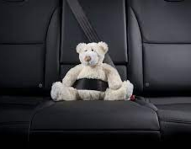
Samples from the data

Slide 23
Data Split
TRAIN
87 %
VALIDATION
TEST
11 %
2 %

Slide 24
DATA Augmentation X 3
DATA PROCESSING
Resize
640x640
Flip
Rotation
Horizontal
Between -15° and +15°
Crop
Brightness
0% Minimum Zoom, 14% Maximum Zoom
Between -15% and +15%

Slide 25
Evaluation Metrics
P
R
MAP
.908
.869
.91
TRAIN
908
.869
.91
VALID

Slide 26

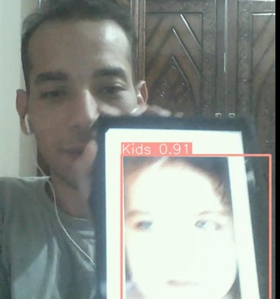
Real-time testing results under different conditions

Slide 27
Real-time testing results under different conditions

Slide 28

Embedded Linux
05

Slide 29
Roles of the Head unit
01
02
03
04
Run Ai models
Operate a Camera
Provide an environment for the Ai models
Handle the camera that gives video to the models
Infotainment system
Coordinating ECUs
Program that provide some visualization to the driver
Sending and receiving messages from the ECUs

Slide 30
Why embedded Linux
1
2
3
Customizability
Stability
Support for AI
5
4
Cost-Effective
Wide Hardware Support
Embedded Linux: A slimmed-down Linux for devices like Raspberry Pi, focused on real-time tasks and low resource usage.
Notes:
Highly adaptable to meet specific hardware and performance requirements.
Proven reliability with robust security features, widely used in critical applications
Compatible with popular AI frameworks like TensorFlow and PyTorch, facilitating easy integration of AI models.
Reduces development costs due to its open-source nature and extensive pre-existing development tools, libraries, and documentation available for efficient development.
Supports a broad range of hardware platforms, from low-power microcontrollers to powerful processors.

Slide 31
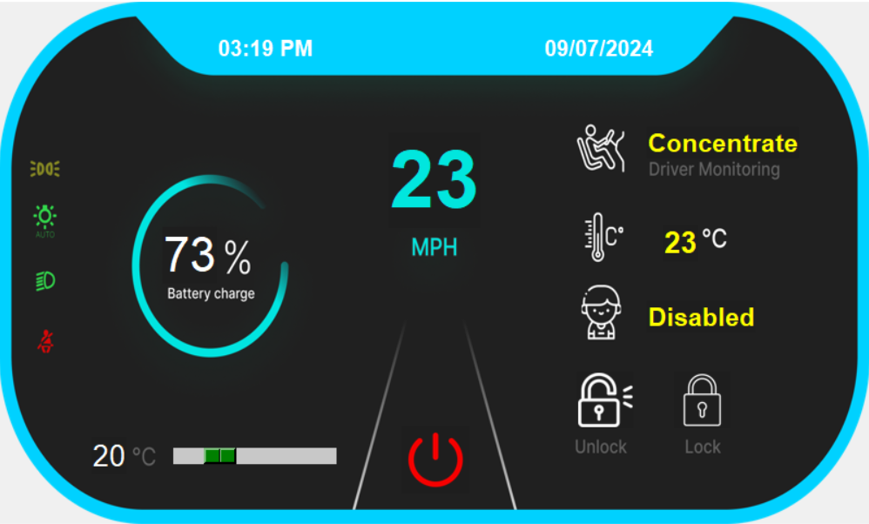
Dashboard
Output of driver monitoring
Output of child detection

Slide 32
Communicating with ECUs
Received data
Sent data
Speed
Driver status
Temperature
Child status
Battery percentage
Lock and Unlock
Wanted temperature

Slide 33
06
ECUs
STM32F103C6 (bluebill)

Slide 34
Bare Metal Programming
UART
GSM
Universal Asynchronous Receiver-Transmitter
Global System for Mobile Communications
GPS
GSM
Global System for Mobile Communications
Global Positioning System

Slide 35
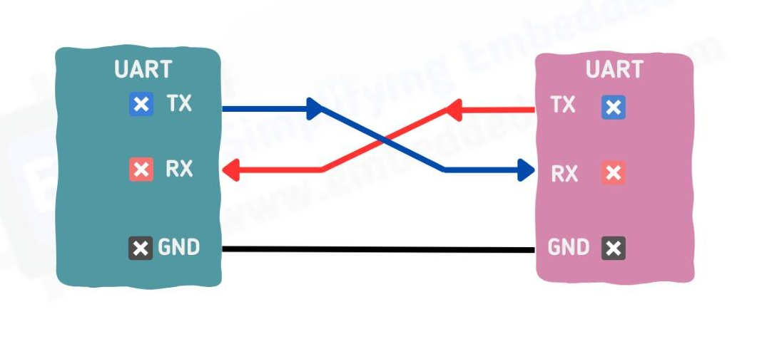
UART
GSM
GPS
GSM
Communication Protocol :
Used in serial communication systems.
Asynchronous Data Transmission:
Operates without a shared clock signal.
There are four parameters to be configured:-
1- Baud Rate
2- Data Bits
3- Parity
4- Stop Bits
Global System for Mobile Communications
TX : Transmitter bin
Rx : Receiver bin
GND : Ground bin

Slide 36
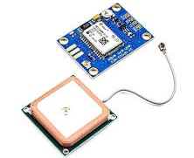
GPS
UART
Is a satellite-based navigation system providing location and time information globally.
Operational Principle: Utilizes a network of satellites that transmit signals to GPS receivers.
Satellites: Orbit the Earth, transmitting signals .
Receivers: Interpret signals to determine exact location, speed, and time.
We receives from satellite every one second messages like : “$GPGGA,162926.00,3029.53944,N,03102.96955,E,1,08,0.98,23.0,M,16.5,M,,*6F ”
Then we parse it to get latitude and longitude .
Finally we generate an link to location of car on map .
VCC : 5 V Supply
TX : Transmitter bin
Rx : Receiver bin
GND : Ground bin

Slide 37
GPS
GPS
GPS
Link be like https://www.google.com/maps/search/?api=1&query= latitude , longitude
After that we send it to the STM which connected with GSM as we see next.
Flow of Control
Start
Connect with Satellite
Locate Device (Car)
End
Transmits coordinates to Other STM
Parse coordinates

Slide 38
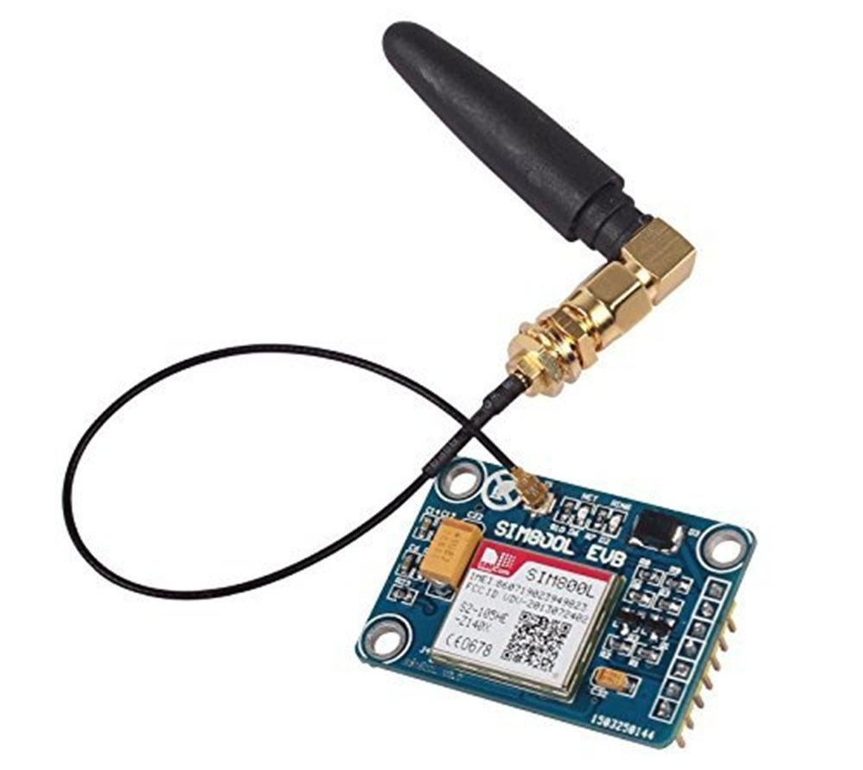
GSM
GPS
GPS
GPS
Is a globally accepted standard for mobile telecommunications .
Operational Principle: Enables devices to send and receive data over GSM networks using AT commands.
AT Command Set: Communicates with microcontrollers using standard AT commands for tasks like SMS, voice, and data transmission.
EX: For send SMS “AT+CMGF=1 ” then “AT+CMGS=“phone number"”
Then message and Finally ctrl+z .
So we send SMS to Car Owner to inform him about his forgotten child in the car .
This message also include the location of the car which received from the STM that connected with GPS.
VCC : 5 V Supply
GND : Ground bin
VDD : 5v Supply
TX : Transmitter bin
Rx : Receiver bin
GND : Ground bin
RST : Reset bin

Slide 39
GSM
GSM
GSM
The SMS be like “Hello, how are you? you forget your Child in the Car :{ ----- Location map : https://www.google.com/maps/search/?api=1&query= latitude, longitude :( ”
Flow of Control
Start
Connect with Network
Receive Coordinates from other STM
End
Send SMS Message
Generate SMS Text

Slide 40
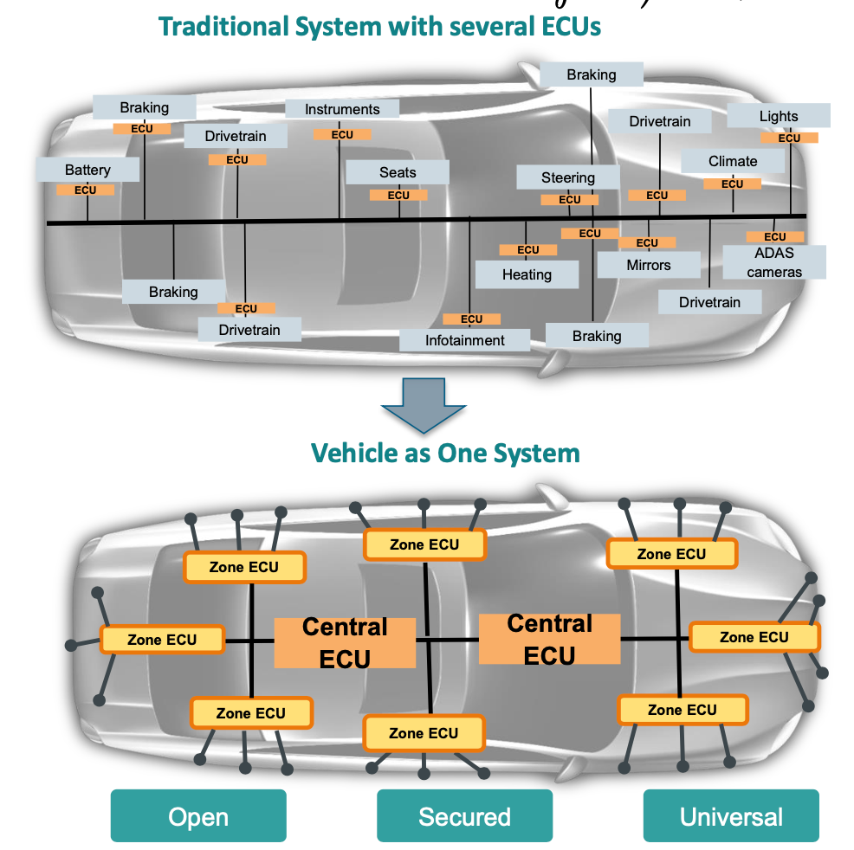

Slide 41
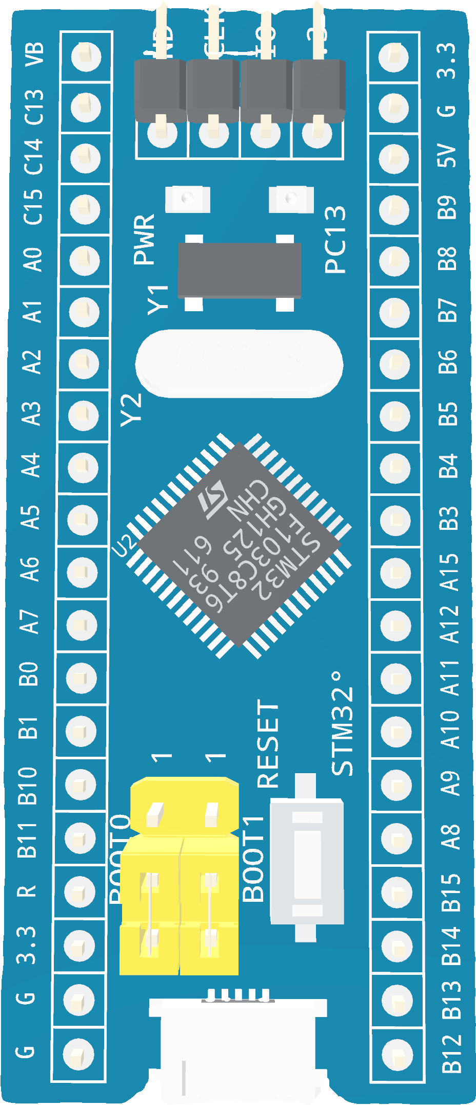
Why Stm32f103c6
ARM Cortex-M3 Core
Operates up to 72 MHz
Advanced Communication
(CAN Interface, USART, SPI, and I2C)

Slide 42
In-Vehicle Networks (IVNs)

Slide 43
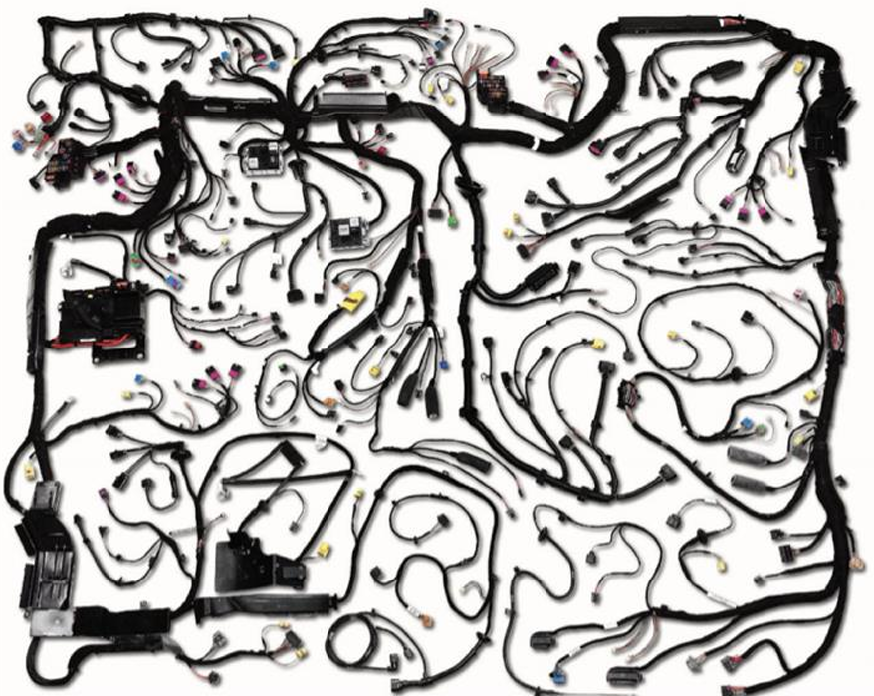
Cables stretch over a mile

Slide 44
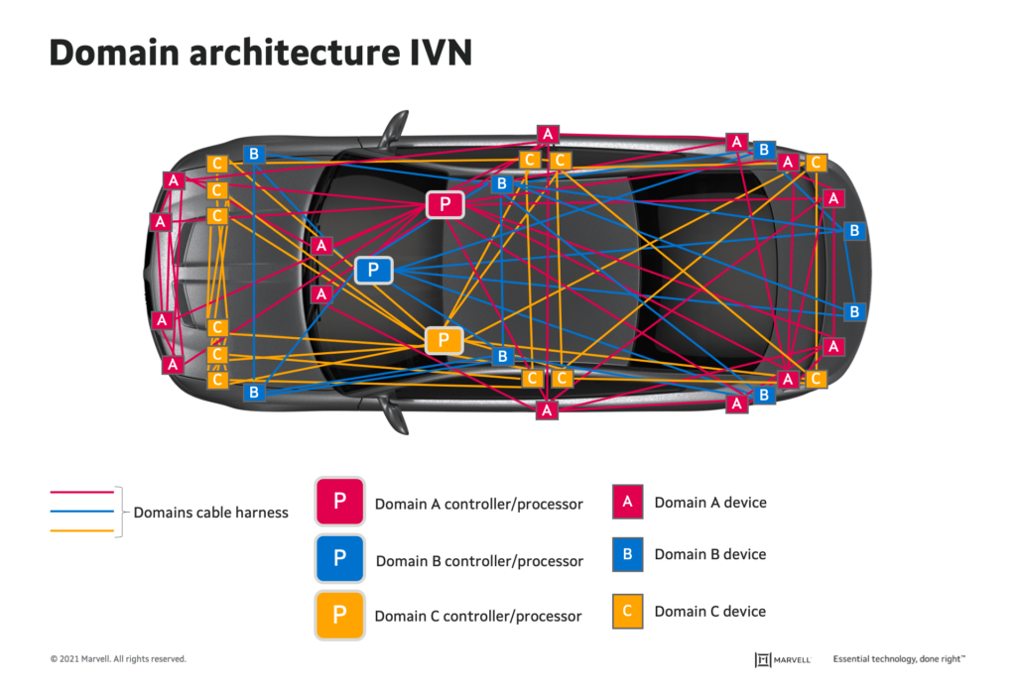

Slide 45
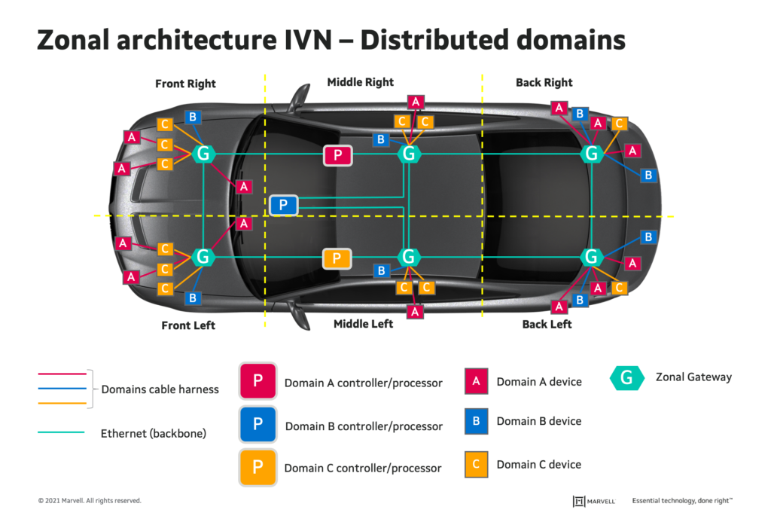

Slide 46
Why CAN bus
ROBUST
Low cost
Reliable
Network multiple microcontrollers with 1 pair of wires
Effecient

Slide 47
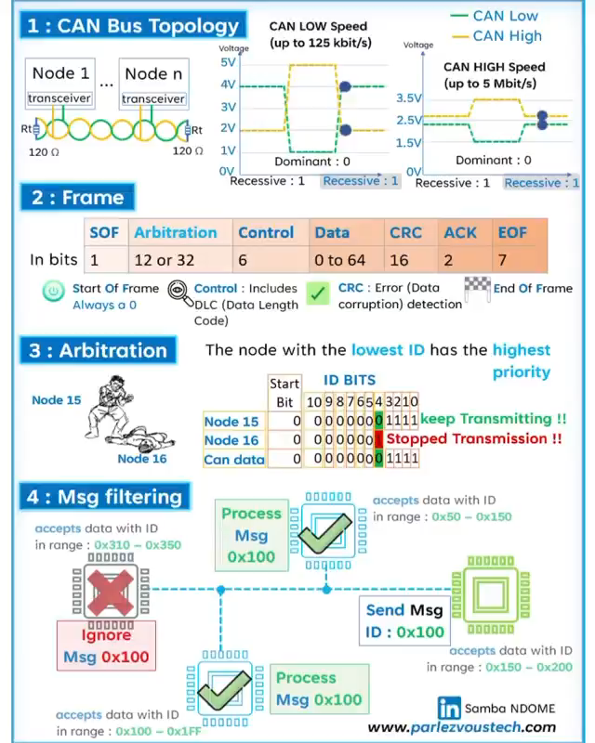

Slide 48
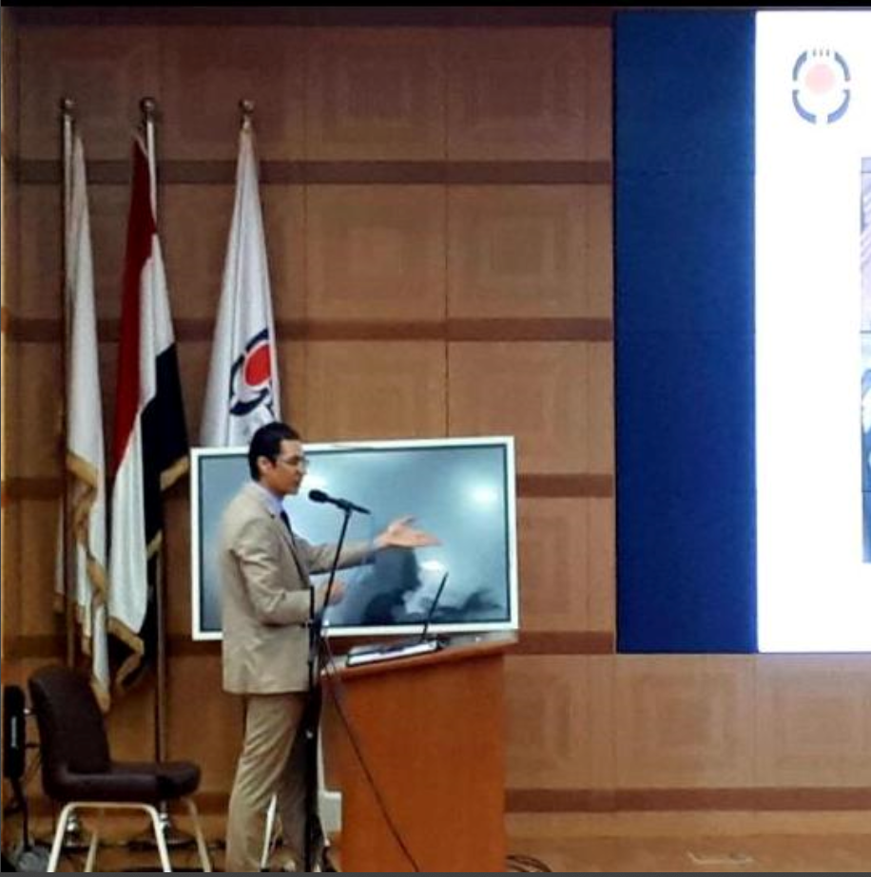






Our team
Dr. Abdullah Nabil
Mohamed Ahmed
Osama Gabr
Ahmed Gaber
Khaled Salama
Mohamed Khairy
Mohamed Anwar

Slide 49
Thank You !
Do you have any questions?

